Slide 1
C# tips

Slide 2
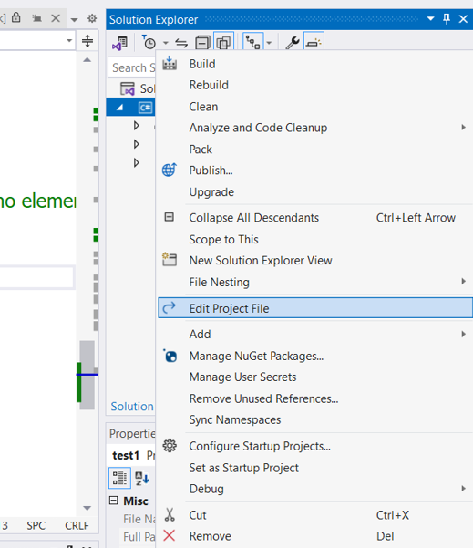
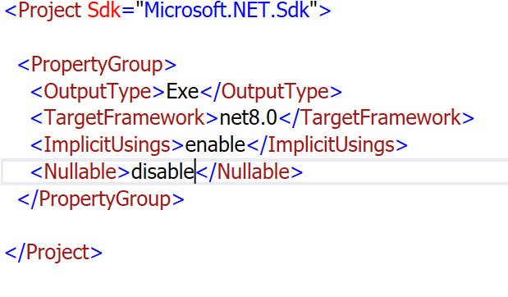
How to Disable nullability
On project level

Slide 3
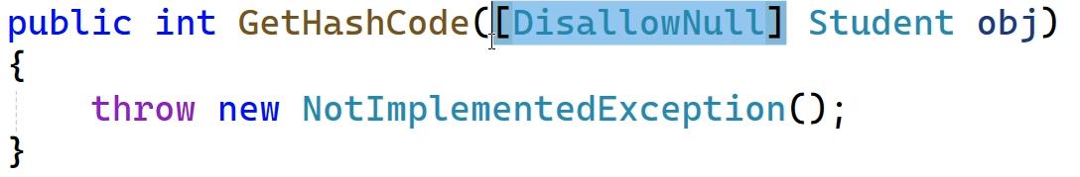
How to Disable nullability [cont]
On File level → #nullable disable
On parameter level

